Slide 1
2D Image Processing and Generation with Texture Operators (TOPs)
David Meredith
dave@create.aau.dk

Slide 2
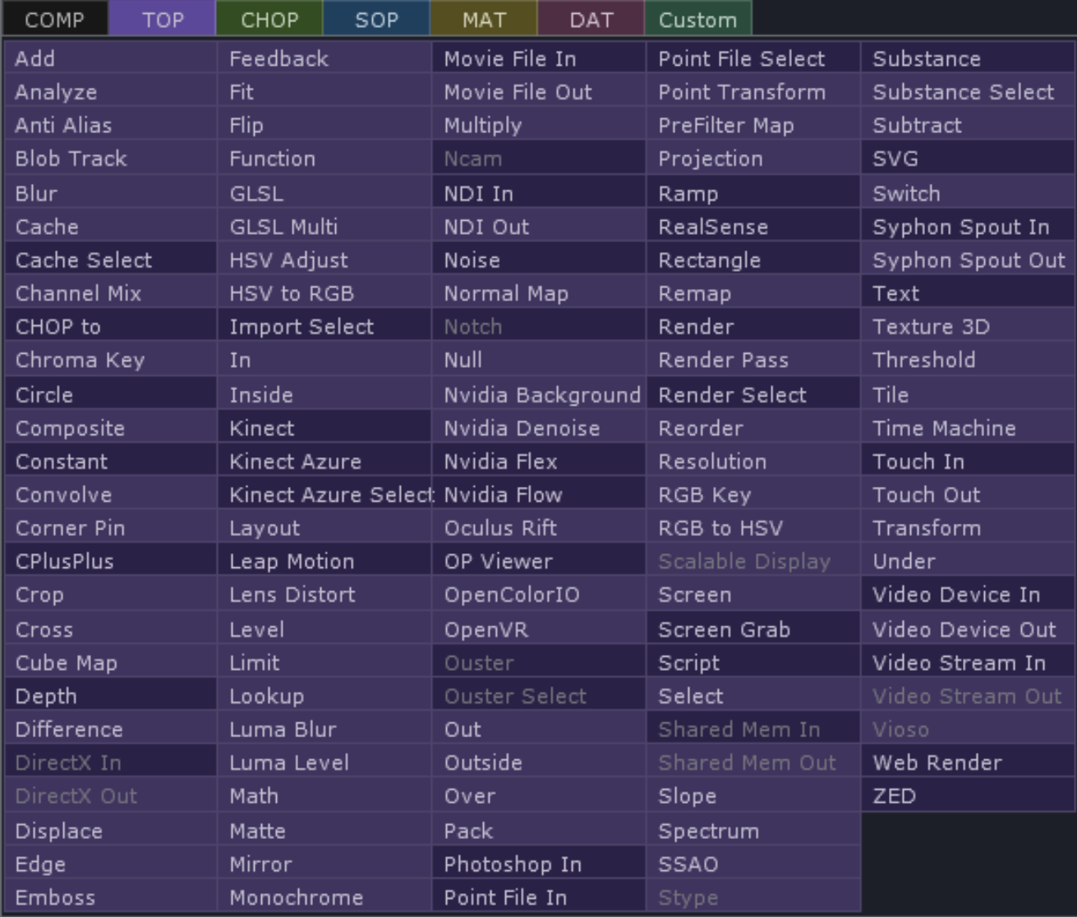
Texture Operators (TOPs) https://docs.derivative.ca/TOP
TOPs are image operators that provide real-time GPU-based compositing and image manipulation
Used for
Preparing textures
Compositing streams, images and movies
Building control-panel elements
Manipulating 32-bit floating point data
…and lots of other stuff
Support many formats, including floating-point image formats for working with HDR images

Slide 3
Texture Operators (TOPs) https://docs.derivative.ca/TOP
All renders and composites occur offscreen with TOPs
Data can be scaled to any resolution, limited only by hardware
TOPs can hold point cloud data where each pixel holds 32-bit XYZ coordinates
Right-click on viewer and select View as Points
Non-commercial limited to 1280 x 1280 resolution

Slide 4
Texture Operators (TOPs) https://docs.derivative.ca/TOP
127 TOPs in the OP CREATE dialog
Some are greyed out in the non-commercial version
Ones with a darker background generate textures
Ones with lighter background filter textures to produce new textures
All TOPs documented at: https://docs.derivative.ca/Category:TOPs

Slide 5
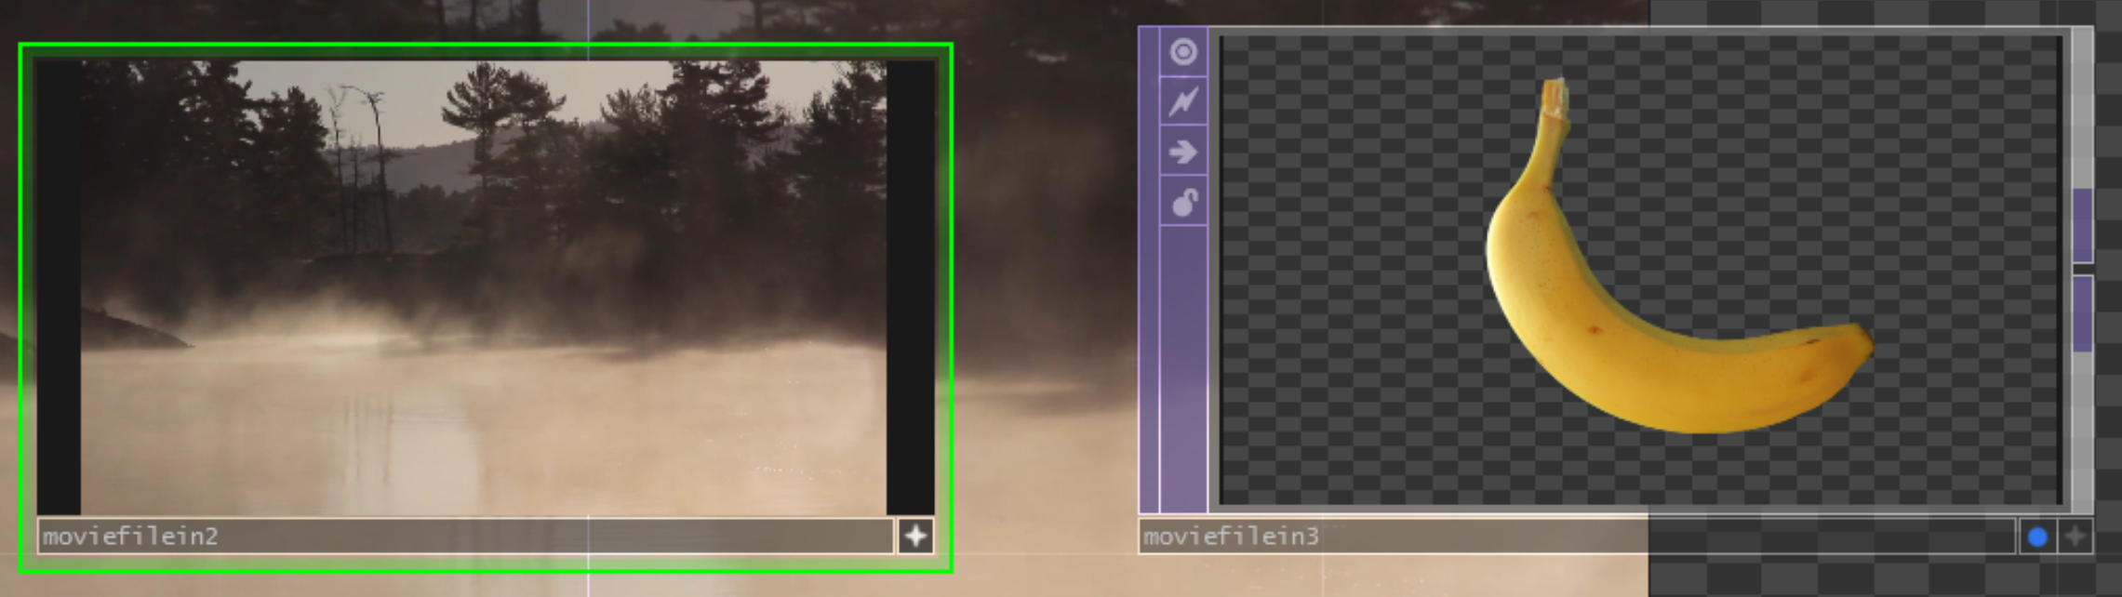
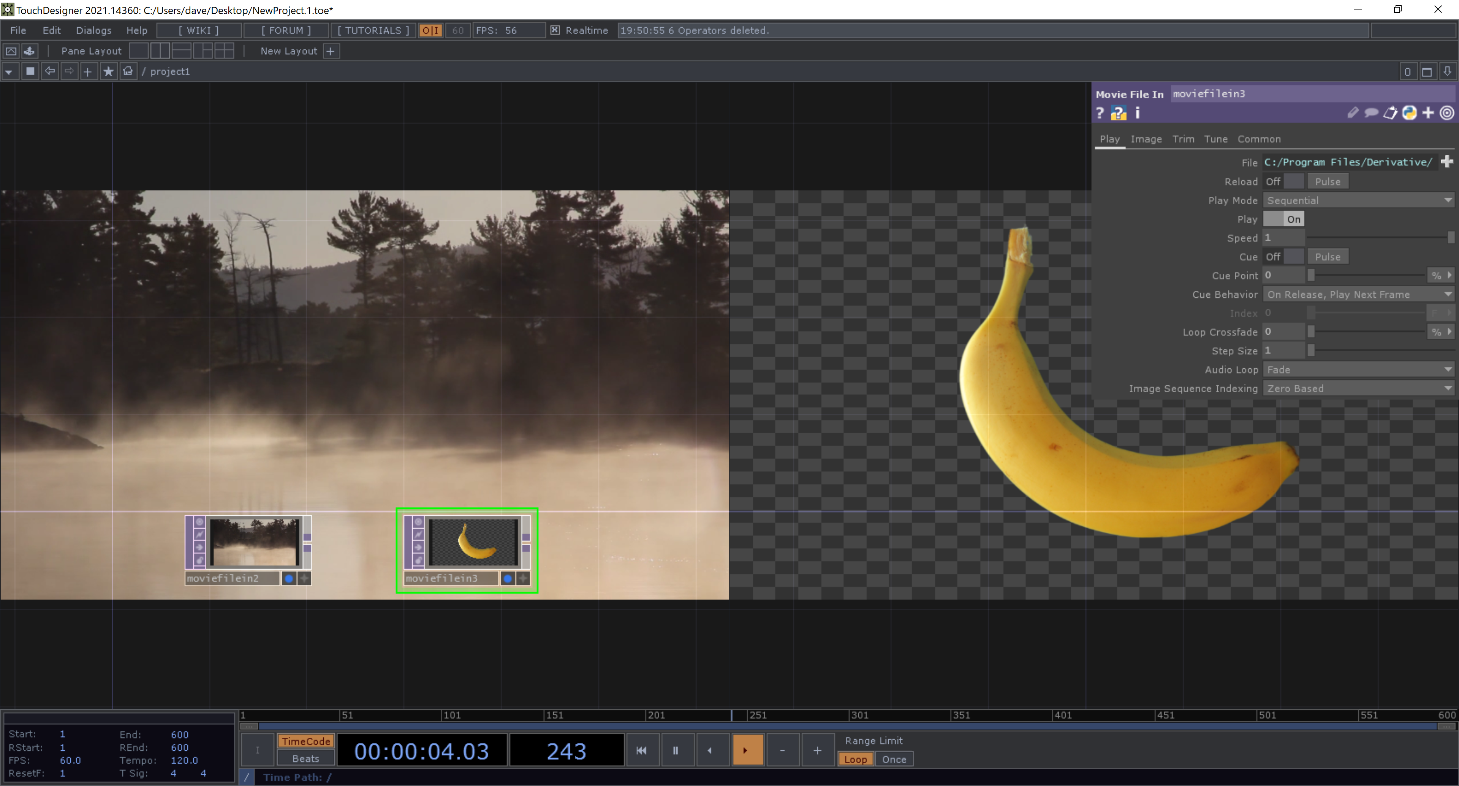
TOP flags TOPs/TOPFlags.toe
Viewer active flag
Display flag
A TOP has two flags in its bottom right-hand corner:
Display flag
Displays TOP output as background of network pane
Turning on display flag on multiple TOPs causes all of them to be displayed side-by-side as the background
Viewer Active flag

Slide 6
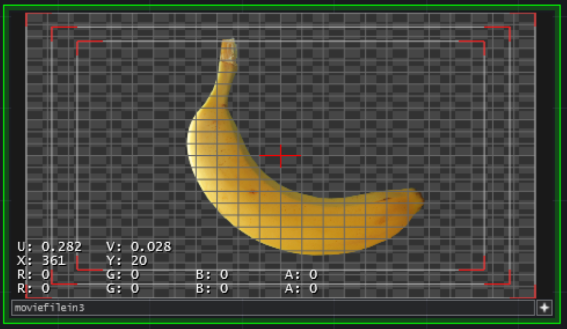
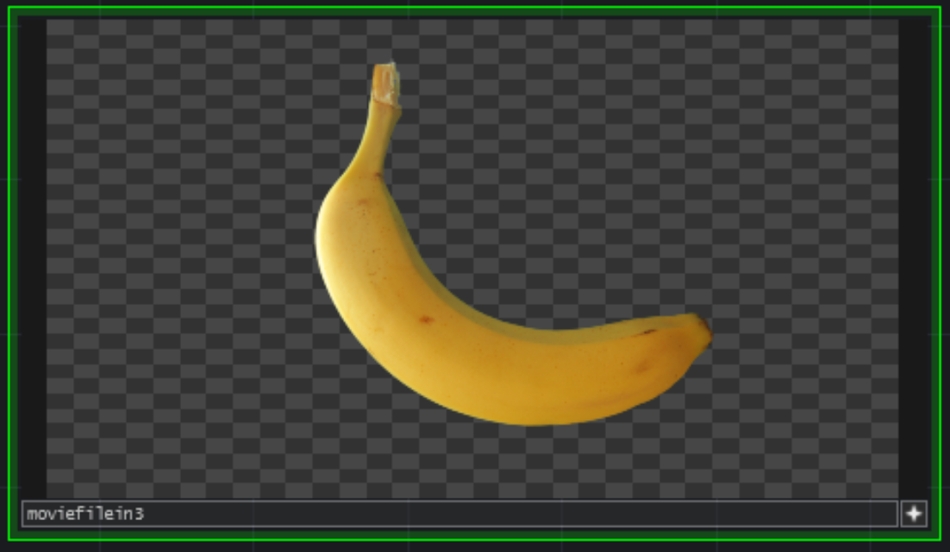
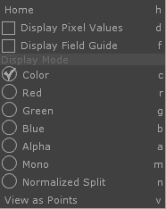
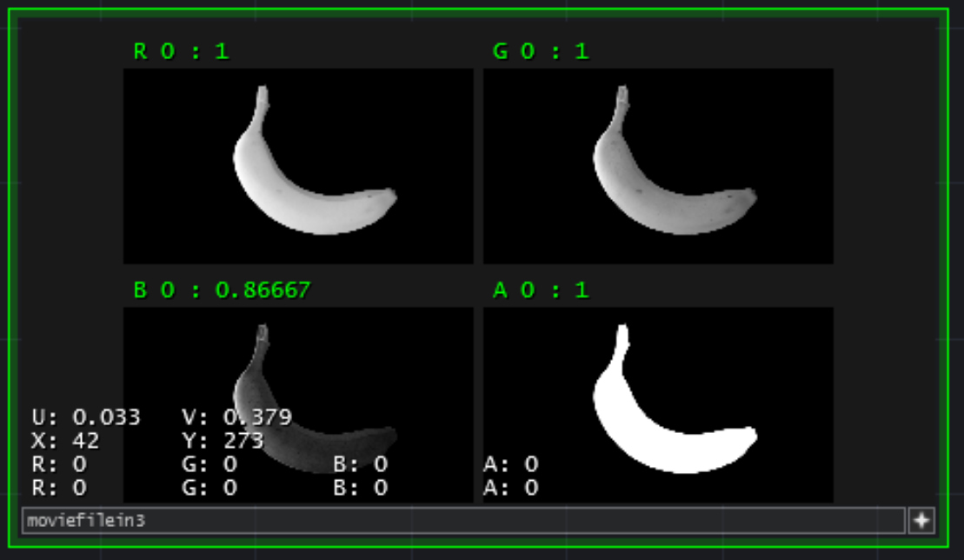
TOP Viewers
TOPs have interactive Node Viewers
Need to have Viewer Active Flag on in order to interact with a TOP’s node viewer
If alpha channel present, then you’ll see a grey checkerboard background
Turn off in TOPs tab in Preferences, accessible through the main Edit menu (or the TouchDesigner menu on a Mac)
LMB: move around inside a viewer
MMB: zoom in and out (Option – RMB, then drag left and right)
”h”: recenter image in viewer
RMB: opens viewer options menu

Slide 7
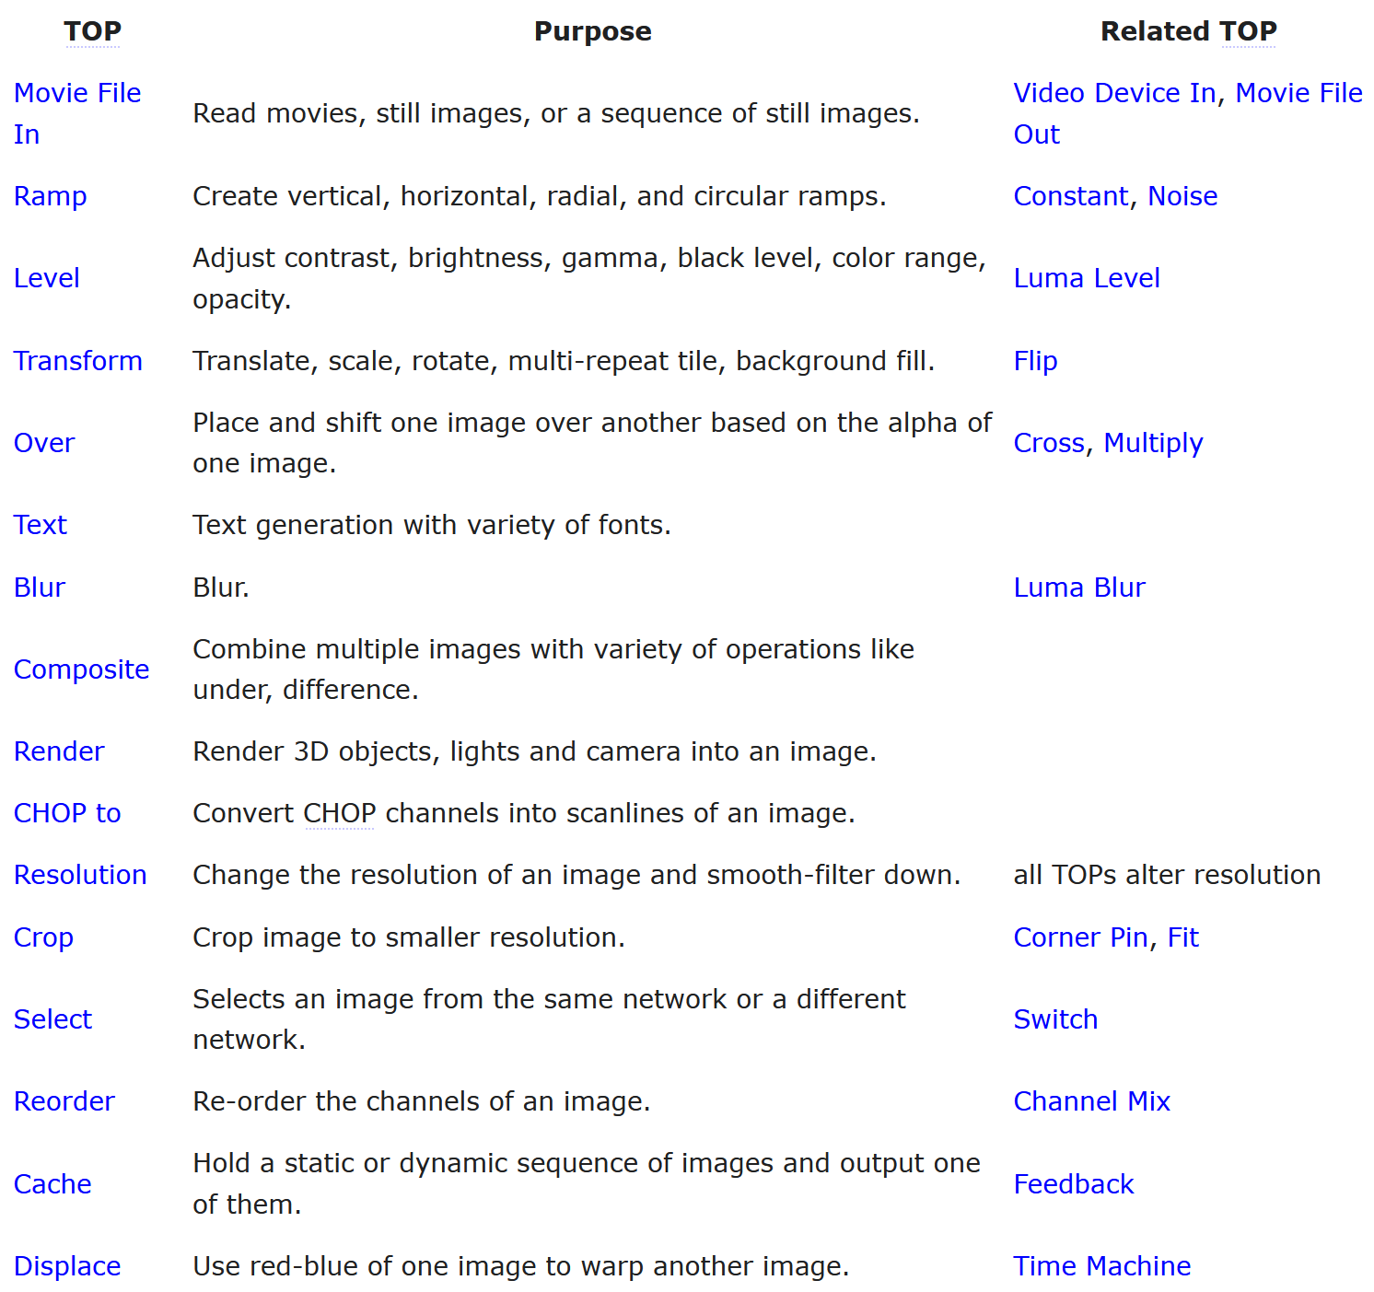
Sweet Sixteen TOPs https://docs.derivative.ca/TOP#Sweet_16_TOPs
The Sweet Sixteen TOPs are a set of 16 TOPs that are commonly used

Slide 8
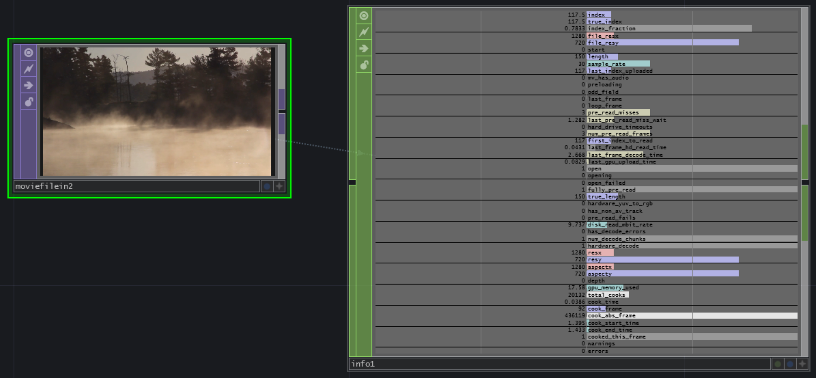
Movie File In TOP https://docs.derivative.ca/Movie_File_In_TOP
Used to load movies, images or sequences of images
Reads following image formats: jpg, gif, tif or bmp
Reads following movie formats. .mov, .mp4, .mpeg, .avi, .wmv, .dpx, Cineform, Hap Q, Hap Q with Alpha
Supports NotchLC codec, EXR files, some .swf and .flv Flash files, DXT1, 3 and 5 compressed DDS file
Can specify location as a URL to fetch movies or images from the web
Can view state of a Movie File In TOP by attaching its output to the input of an Info CHOP

Slide 9
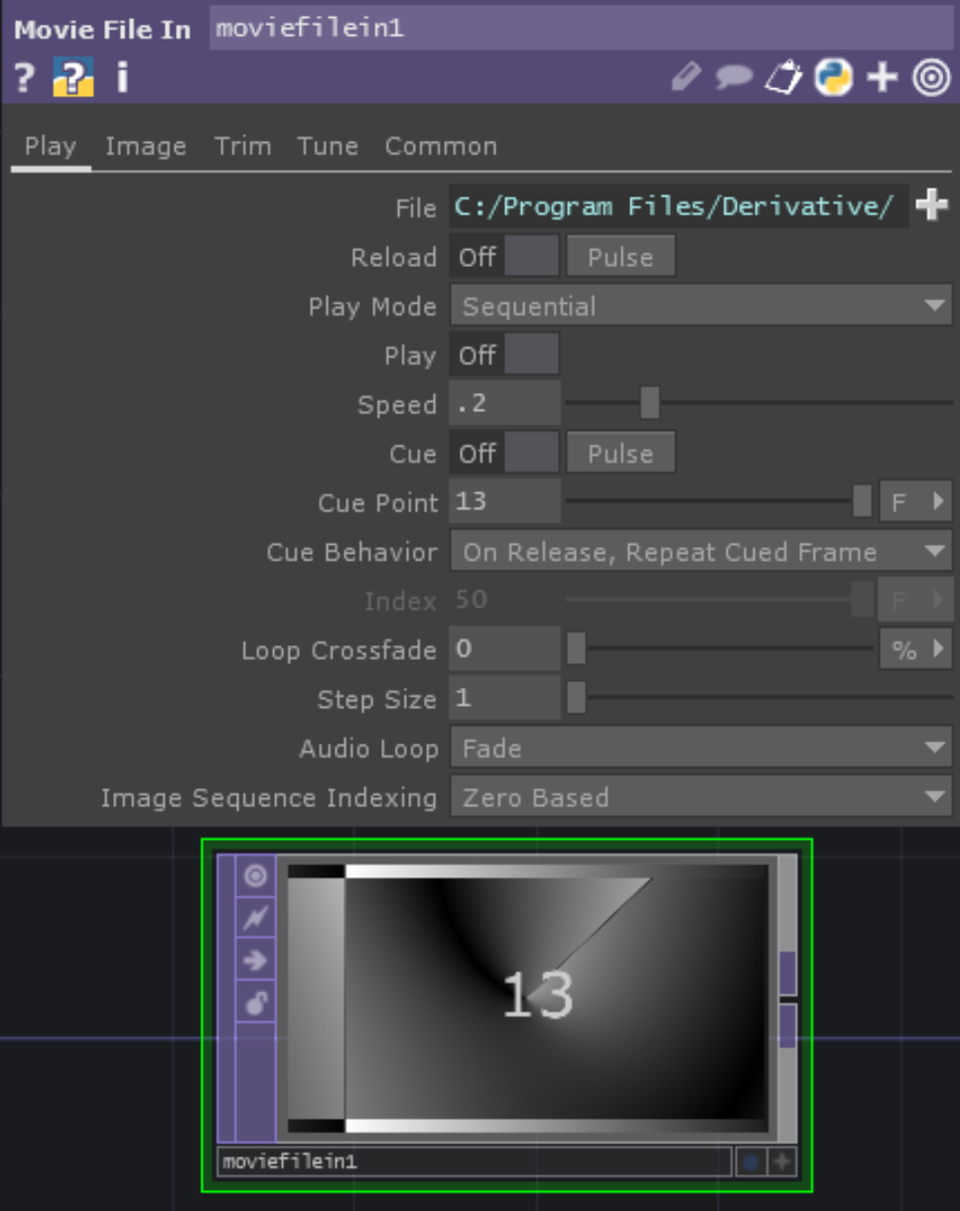
Movie File In parameters: Play page
Play page
File: Path and name of image or file to load; file types are given in https://docs.derivative.ca/File_Types; specify files on internet using a URL
Give name of a folder to load all images in folder as if they are one movie; all files must be the same resolution; order is alphanumeric; override sample rate on Trim page to playback sequence at any frame rate
Reload: Forces image or movie to reload, press pulse to instantly reload the file
Play mode
Sequential:
Runs movie at a speed determined by Speed parameter
If displaying a folder, then displays each file for a period determined by Speed parameter
Lock to Timeline:
Runs a movie at a speed that allows an integer number of runs to occur within the timeline period
If movie has more frames than Timeline, then just plays the first N frames where N is the number of frames in the Timeline
If displaying a folder, cycles through all files within one Timeline period
Specify Index: Set Index parameter type to I, then gives just index of file in collection being displayed; if type set to F, then file shown determined by position of frame in whole cycle.
Play: On or off
Speed: Determines speed of display of movie or collection of files
Cue: Only works with Sequential, jumps to cue point when on; pulse button returns to cue point
Cue point: Can be expressed as percentage, index, frames or seconds
Index: used with play mode Specify Index to explicitly set movie position
Loop crossfade: crossfades beginning and ending of movie to get smooth transition
If use Trim options, then crossfades Trim Start with Trim End positions
Step size: Sets number of frames to skip between displaying frames

Slide 10
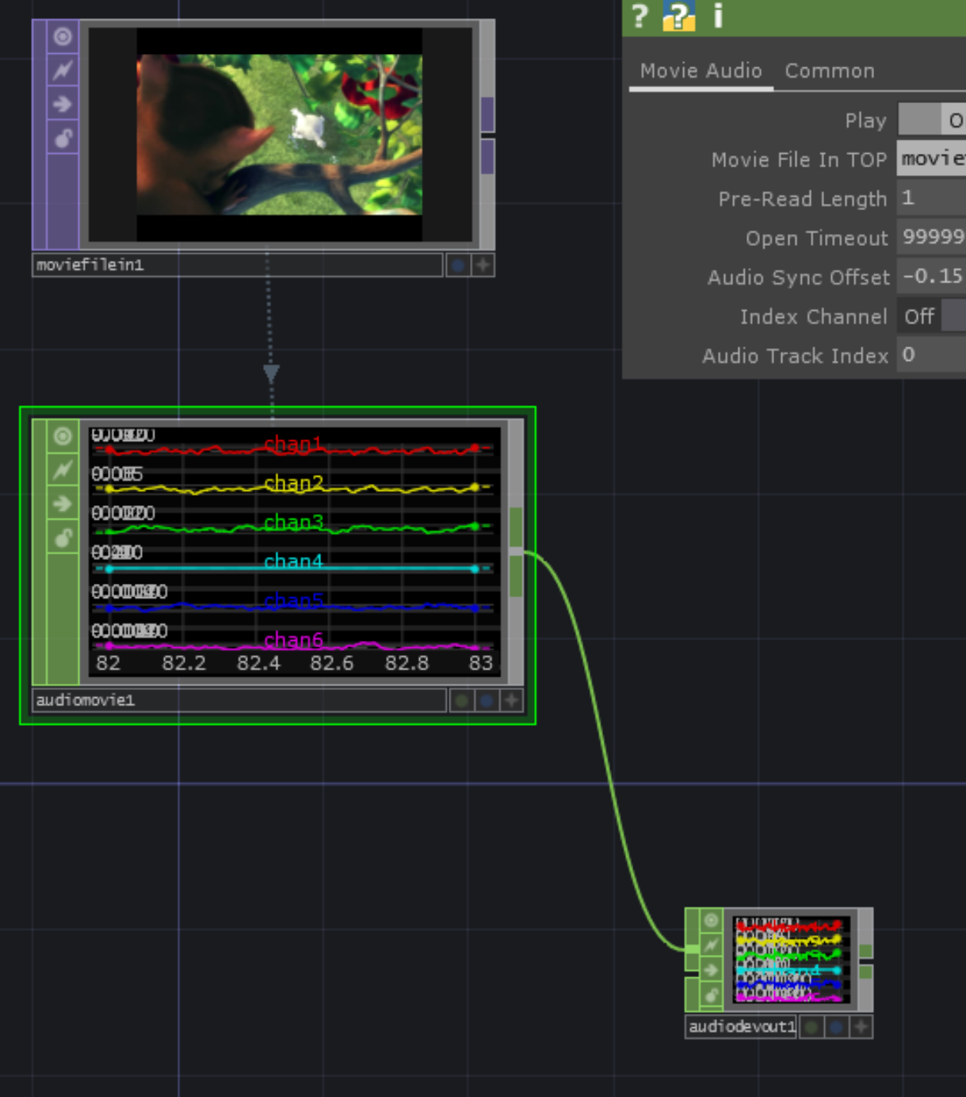
Playing movies with audio
Attach a Movie File In TOP to an Audio Movie CHOP by dragging the Movie File In TOP onto the Audio Movie CHOP
Then attach the Audio Movie CHOP to an Audio Device Out Chop
Make sure that the Device parameter is referring to the right speakers or headphone and that the Driver parameter is using the correct driver

Slide 11
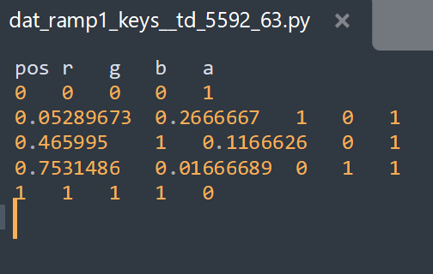
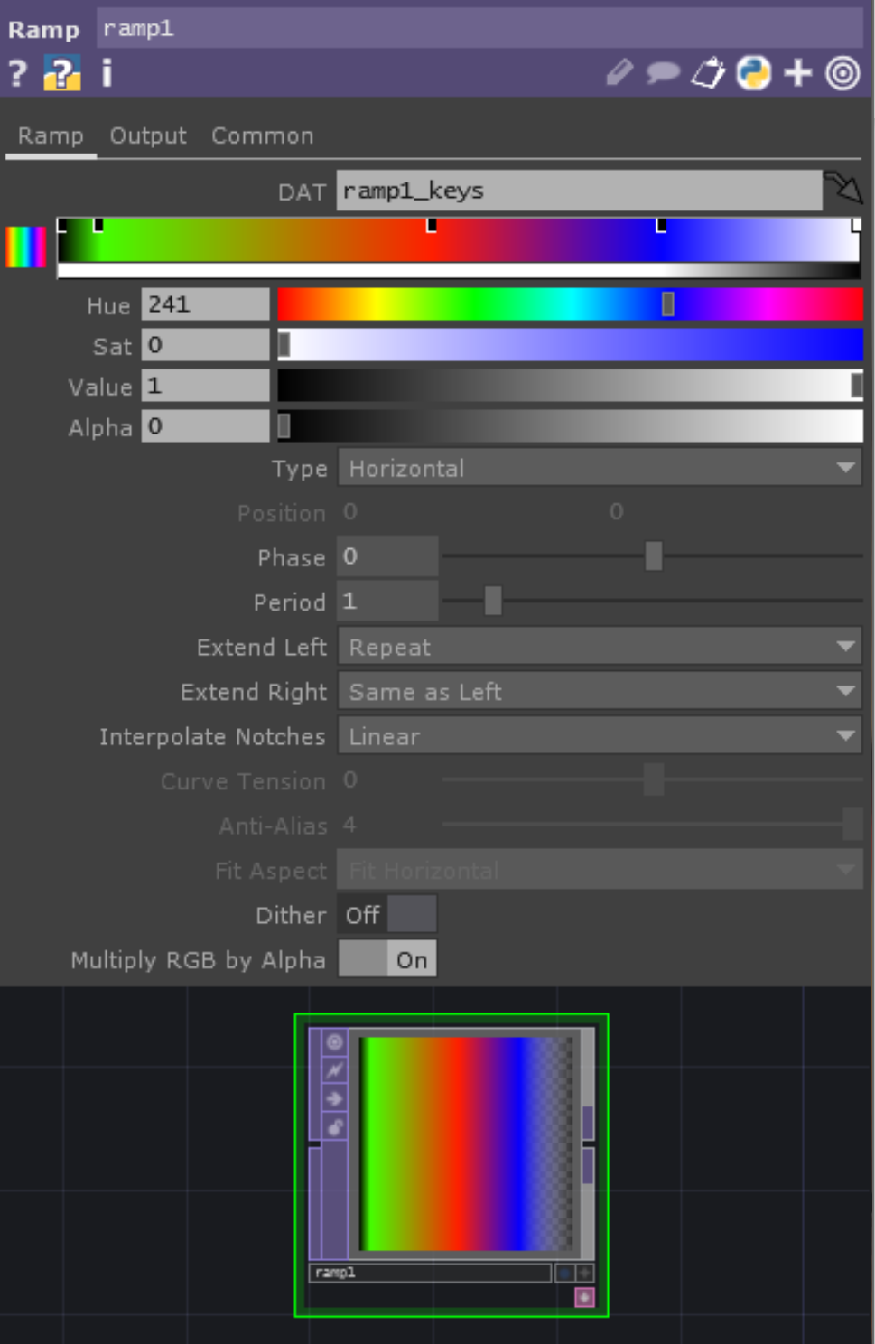
Ramp TOP
Allows you to interactively create vertical, horizontal, radial or circular ramps
Use the ramp bar and color-picker to add keyframes and define the colors at those frames
Drag a keyframe off the ramp bar to remove it
Data for ramp is held in DAT specified in DAT parameter
Each row represents a color keyframe entry in the ramp
Use Option/Alt to scroll in DAT

Slide 12
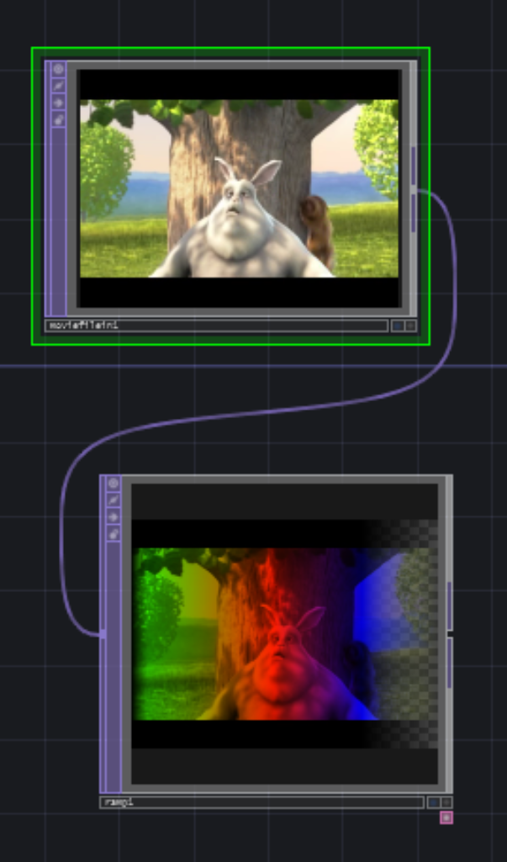
Ramp TOP parameters
Output page
Comp with Input: if on, composites input movie or image with ramp
Operation: Choose the composite operation that is performed
Swap order: Swaps order of composite with input
See effect by using Over or Chroma difference operation

Slide 13
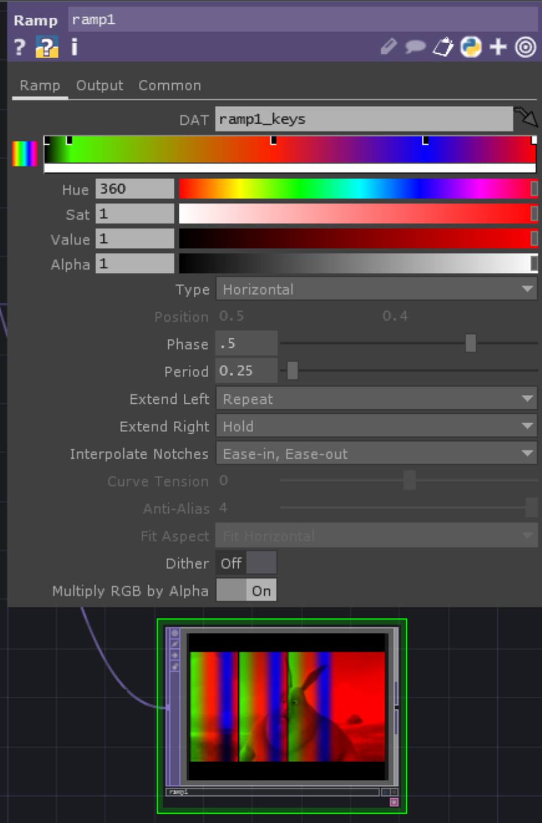
Ramp TOP parameters
Ramp page
Type: vertical, horizontal, radial, circular
Position: sets centre position for radial and circular ramps
(0,0) is centre, (.5,.5) is approx top right corner
Phase: shifts through a proportion of the ramp’s period
Period: determines width of one period of ramp in image/movie, so smaller period means more repetitions of the ramp

Slide 14
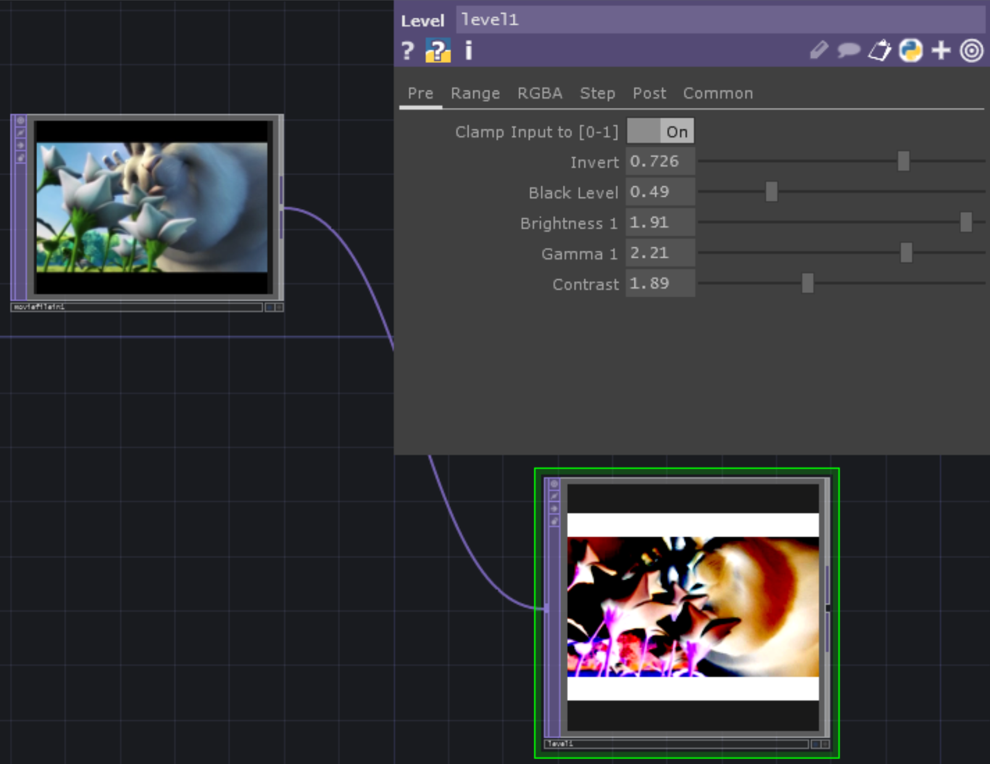
Level and Luma Level TOPs
Level TOP adjusts contrast, brightness, gamma, black level, color range, quantization, opacity and more
Luma Level TOP preserves hue and saturation more accurately

Slide 15
Level TOP Parameters – Pre Page
Clamp Input to [0-1]: clamps pixel values to be within the range 0 to 1 (do not use with higher bit depth floating point pixel formats)
Invert: inverts colors, so that black becomes white and colors are inverted across the color wheel (red -> cyan, blue -> yellow, green -> magenta, etc.)
Black level: blackens any pixel with a value below the given value
Brightness 1: Brightness is mean of RGB channel values for a pixel. Increasing brightness adds amounts to these channels to maintain relative amounts of R G and B, but raising average
Gamma 1: Gamma is relationship between brightness of a pixel on the screen and its numerical value. Defined by a curve. Changing gamma changes relationship between R, G and B

Slide 16
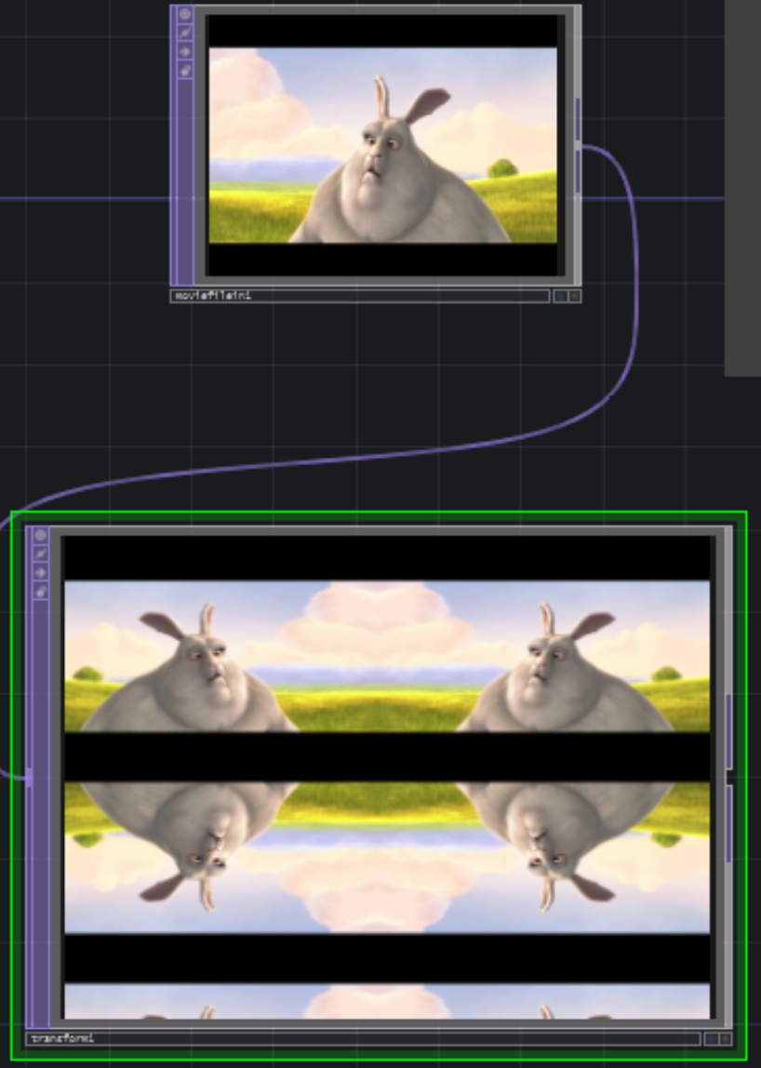
Transform TOP
Applies 2D transformations to a TOP image (e.g., translate, scale, rotate, and multi-repeat tiling)
Background can be filled with solid color and alpha.
Tiling can be mirroring or repeating

